Slide 1
Technical overview LoRaWAN network Professor: Dr.Mehdi Rasti Lecturer: Jaber Babaki Amirkabir University of Technology Spring 2021

Slide 2
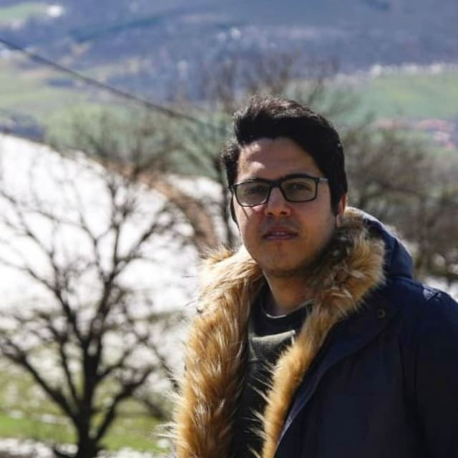
HELLO!
I AM JABER BABAKI
You can find me at:
Email: jaber.babaki@gmail.com
GitHub: https://github.com/JaberBabaki
Linkedin: https://www.linkedin.com/in/jaber-babaki-9b5474102/
Telegram: @jaberALU

Slide 3



Technical overview CSS as a modulation for Long Range Communication
SF | 125 (kHz) |  |  | SNR (dBm) | Range (Km)
 | Bit rate (kb/s) | Sensitivity (dBm) | ToA (ms)
7 | 5.4 | -124 | 56 | -7.5 | 2
8
9
10
11
12 | 0.29 | -137 | 1483 | -20 | 15
$$bit rate(s)=\frac{BW}{2^{sf}}×sf×CR$$
$$bit rate\left(s\right)=\frac{125}{2^{7}}×7×\frac{4}{5}=5.468 kb/s$$
$$bit rate\left(s\right)=\frac{125}{2^{12}}×12×\frac{4}{5}=0.2929 kb/s$$
Code rate: 4/5 Payload: 14 byte

Slide 4






Technical overview CSS as a modulation for Long Range Communication
SF | 125 (kHz) |  |  | SNR (dBm) | Range (Km)
 | Bit rate (kb/s) | Sensitivity (dBm) | ToA (ms)
7 | 5.4 | -124 | 56 | -7.5 | 2
8
9
10
11
12 | 0.29 | -137 | 1483 | -20 | 15
$$T_{on_the_air}=T_{payload}+T_{preamble}$$
$$T_{preamble}=(4.25+8) ×\frac{2^{SF}}{BW}$$
$$T_{payload}=N_{payload}×\frac{2^{SF}}{BW}$$
$$N_{payload}=8+max\left[Ceil\left(\frac{8PL−4SF+28+16−20IH}{4(SF−2DE)}\right)×(CR+4),0\right]$$
$$SF=7 BW=125 kHz Payload=14 byte$$
$$N_{payload}=8+max\left[Ceil\left(\frac{8×14−4×7+28+16}{4(7−2)}\right)×(1+4),0\right]=35+8=43$$
$$T_{payload}=43×\frac{2^{7}}{125}=44.032 ms$$
$$T_{preamble}=\left(4.25+8\right)×\frac{2^{7}}{125}=12.544 ms$$
Code rate: 4/5 Payload: 14 byte
$$T_{on_the_air}=T_{payload}+T_{preamble}=44.032+12.544=56ms$$

Slide 5



Technical overview CSS as a modulation for Long Range Communication
SF | 125 (kHz) |  |  | SNR (dBm) | Range (Km)
 | Bit rate (kb/s) | Sensitivity (dBm) | ToA (ms)
7 | 5.4 | -124 | 56 | -7.5 | 2
8
9
10
11
12 | 0.29 | -137 | 1483 | -20 | 15
$$SNR(SF)=\frac{SNR_{0}}{2^{SF}}$$
$$SNR_{0}=\frac{E_{bit}}{NF}=31 mW (SNR_{0} equals 15 dBm for the SX1272 transceiver)$$
$$SNR\left(12\right)=\frac{31}{2^{12}}=0.007mW=−21dBm$$
$$SNR\left(7\right)=\frac{31}{2^{7}}=0.24218 mW=−6.2dBm$$
Code rate: 4/5 Payload: 14 byte

Slide 6
Technical overview CSS as a modulation for Long Range Communication
SF | 125 (kHz) |  |  | SNR (dBm) | Range (Km)
 | Bit rate (kb/s) | Sensitivity (dBm) | ToA (ms)
7 | 5.4 | -124 | 56 | -7.5 | 2
8
9
10
11
12 | 0.29 | -137 | 1483 | -20 | 15
$$Receiving sensitivity=−174+6+10\log_{ }{BW}+SNR$$
$$Receiving sensitivity \left(12\right)=−174+6+51−21=−138$$
$$Receiving sensitivity \left(7\right)=−174+6+51−6.1=−123.1$$
Code rate: 4/5 Payload: 14 byte

Slide 7
Technical overview CSS as a modulation for Long Range Communication
SF | 125 (kHz) |  |  | 250 (kHz) |  |  | 500 (kHz) |  |  | SNR (dBm) | Range (Km)
 | Bit rate (kb/s) | Sensitivity (dBm) | ToA (ms) | Bit rate (kb/s) | Sensitivity (dBm) | ToA (ms) | Bit rate (kb/s) | Sensitivity (dBm) | ToA (ms)
7 | 5.4 | -124 | 56 | 110 | -122 | 20 | 219 | -116 | 10 | -7.5 | 2
8 |  |  |  |  |  |  |  |  |  |  | 4
9 |  |  |  |  |  |  |  |  |  |  | 6
10 |  |  |  |  |  |  |  |  |  |  | 8
11 |  |  |  |  |  |  |  |  |  |  | 10
12 | 0.29 | -137 | 1483 | 0.5 | -135 | 495 | 0.98 | -129 | 247 | -20 | 15

Slide 8
Reference
[1] Peter J. Ryan 1 and Richard B. Watson, “Research Challenges for the Internet of Things: What Role Can OR Play?” , systems journal, 14 March 2017.
[2] P.P.Ray, A survey on Internet of Things architectures, Journal of King Saud University - Computer and Information Sciences, Volume 30, Issue 3, July 2018, Pages 291-319.
[3] LPWAN white paper, Leverege LLC, 2020 | www.leverege.com
[4] J. Babaki, M. Rasti and R. Aslani, "Dynamic Spreading Factor and Power Allocation of LoRa Networks for Dense IoT Deployments," 2020 IEEE 31st Annual International Symposium on Personal, Indoor and Mobile Radio Communications, 2020, pp. 1-6, doi: 10.1109/PIMRC48278.2020.9217283.
[5] What is LoRaWAN® Specification, https://lora-alliance.org/about-lorawan/

Slide 9
Reference
[6] V. Talla, M. Hessar, B. Kellogg, A. Najafi, J. R. Smith, S. Gollakota, “LoRa Backscaer: Enabling The Vision of Ubiquitous Connectivity”, Proceedings of the ACM on Interactive, Mobile, Wearable and Ubiquitous Technologies, 2017/9/11.
[7] LoRa™ Modulation Basics, SEMTECH.
[8] Link Budget Calculation, Training materials for wireless trainers, ICTP.
[9] T. Bouguera, J.F. Diouris , J.J Chaillout, R.Jaouadi, G. Andrieux, “Energy Consumption Model for Sensor Nodes Based on LoRa and LoRaWAN”, sensors, 30 June 2018.
[10] E. Ruano, LoRaTM protocol Evaluations, limitations and practical test, May 11, 2016
[11] WIRELESS NETWORKING IN THE DEVELOPING WORLD, http://wndw.net

Slide 10
THANKS!
You can find me at:
Email: jaber.babaki@gmail.com
GitHub: https://github.com/JaberBabaki
Linkedin: https://www.linkedin.com/in/jaber-babaki-9b5474102/
Telegram: @jaberALU

